Slide 1

AI-DRIVEN PUBLIC HEALTH CHATBOT FOR DISEASE AWARENESS Project Term (January – April 2026) Submitted By Gutha Sahith Chowdary Reg No: 12201291 Kamadula Siddartha Reg No: 12200271 Vutti Ajay Reg No: 12200245 Under the Guidance of Arshiya Assistant Professor, Department of CSE

Slide 2
AGENDA
Introduction
Problem Statement
Research Gap
Proposed Solution
Key Features
Architecture Flow
Tech Stack
Application Interface
Future Scope
Conclusion

Slide 3
INTRODUCTION
A smart healthcare assistant designed to improve public health awareness
Provides symptom analysis, guidance, and consultation support
Uses Artificial Intelligence to deliver safe and scalable solutions
Helps users understand symptoms and take informed health decisions
Supports text and voice interaction for better accessibility
Reduces dependency on overcrowded public health centers for basic consultations
Aligns with Smart India Hackathon (SIH25049) problem requirements

Slide 4
PROBLEM STATEMENT
System should operate at a public health (epidemiology) level, not individual diagnosis
Provide simple and clear health-related information
Perform basic symptom-based triage
Identify and escalate severe or critical cases to medical professionals
Must support multi-modal interaction(text & voice)

Slide 5
RESEARCH GAP
Existing public health chatbots are mostly rule-based (FAQ systems)
Telemedicine platforms rely on human doctors only
Lack of structured and auditable interaction records
Need for a system that is safe, scalable, auditable, and AI-assisted, combining deterministic triage with controlled AI interaction

Slide 6
PROPOSED SOLUTION
A web-based platform designed to be scalable, accessible, and cost-effective
Implements a 3-stage integrated workflow
Combines deterministic triage + AI conversation + automated summarization
Maintains user-specific records and history
Generates structured medical reports and enables follow-up interaction

Slide 7
KEY FEATURES
Symptom Triage: Structured intake and analysis of user-reported symptoms
Risk Detection: Automated severity scoring across four actionable tiers
Specialist Routing: Recommends the appropriate medical specialist based on symptom profile.
Contextual AI Chat: LLM-powered consultation with injected medical context per session.
Meeting Transcription: Auto-generated summaries of AI consultation sessions.
Follow-Up Q&A: Post-consultation question system for ongoing user clarity.

Slide 8
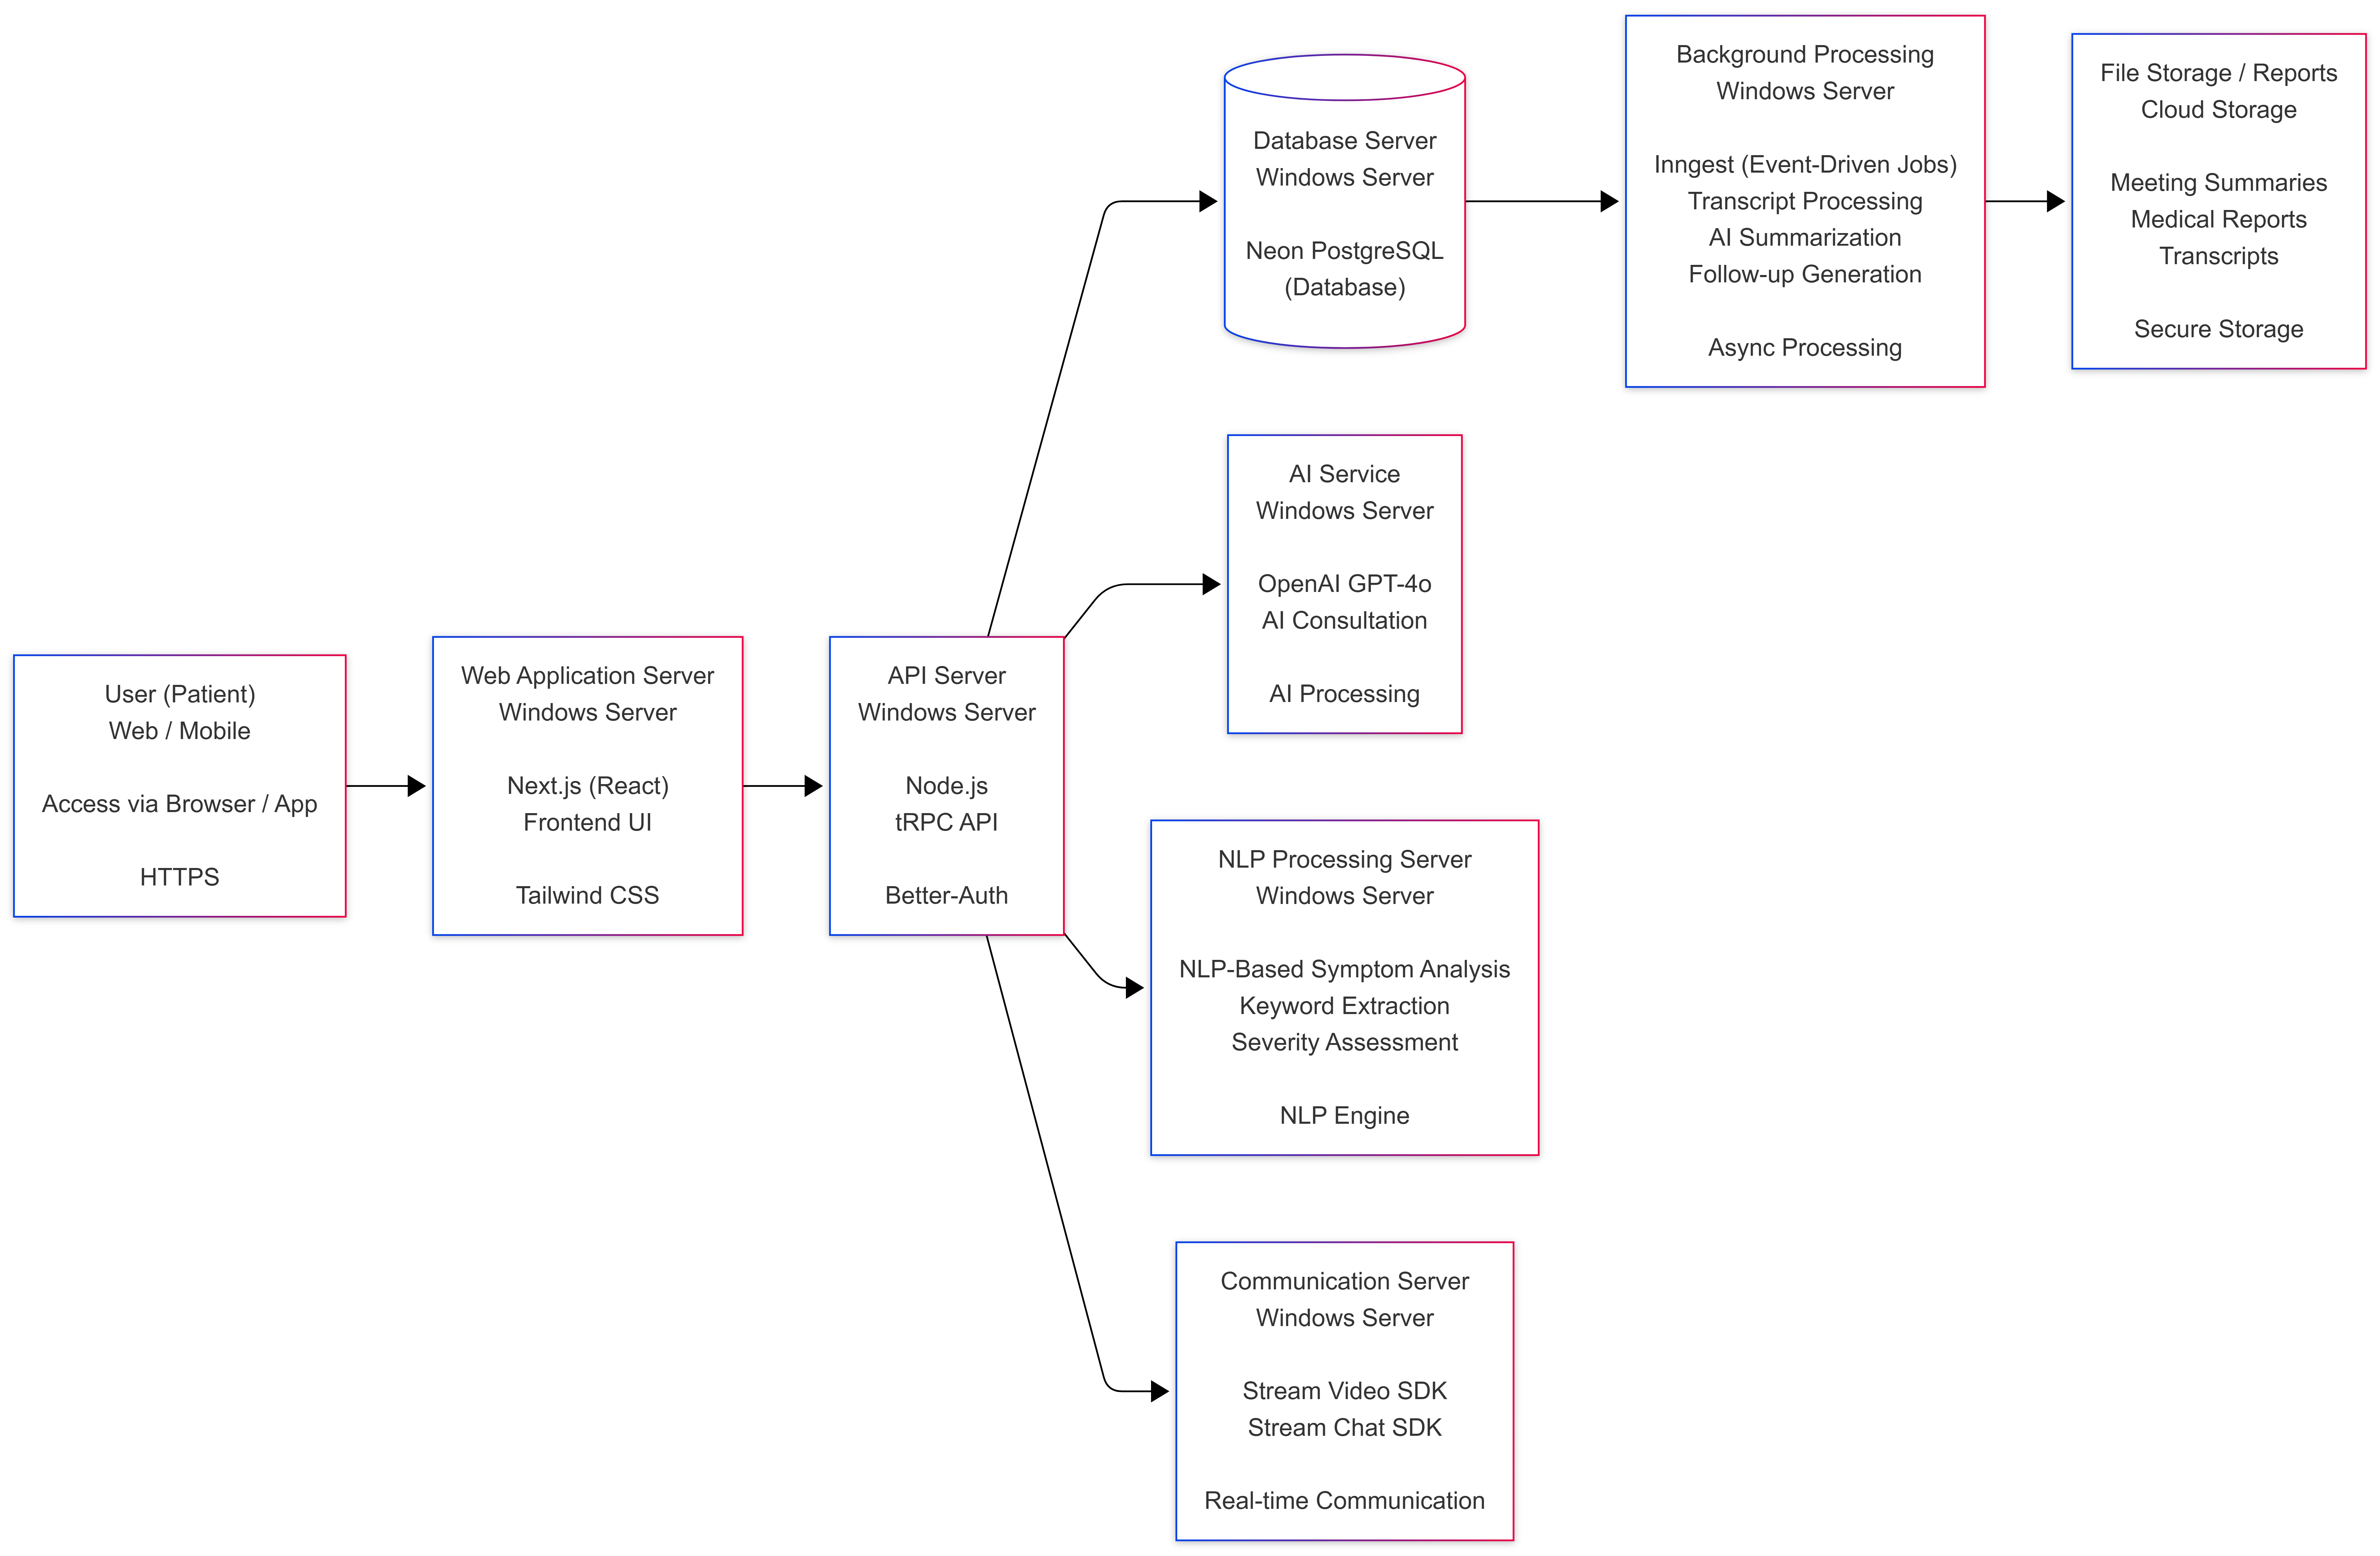
ARCHITECTURE FLOW

Slide 9
TECH STACK
Frontend
Next.js 15
React 19
Tailwind CSS
TypeScript
Database & API
NeonDB (Postgres)
Drizzle ORM
tRPC
TanStack Query
Auth & Real-Time
BetterAuth
Stream Video SDK
Stream Chat SDK
Webhook Orchestrator
Ai & Background Jobs
Decision Engine (NLP)
OpenAI Realtime API
GPT-4o Chat
Inngest + Agent Kit

Slide 10
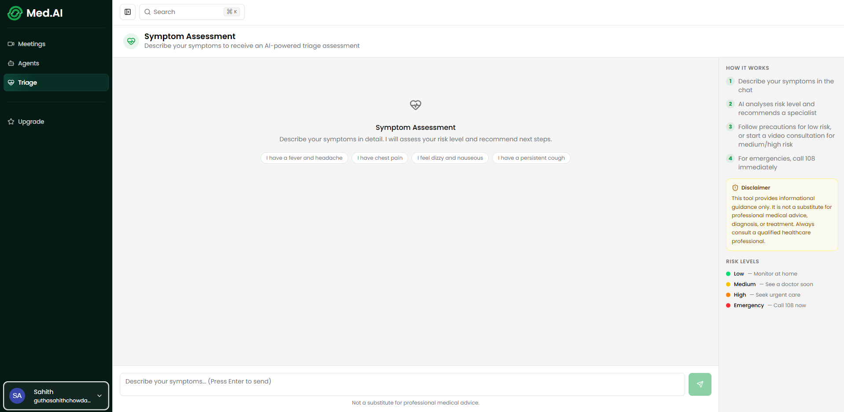
APPLICATION INTERFACE

Slide 11
FUTURE SCOPE
Doctor Dashboard Integration: Enable doctors to view triage data and AI summaries
Human Doctor Consultation: Escalate AI consultations to real doctors via video calls
Support multi-party consultations (AI + Doctor + Patient)
Multilingual Support: Add support for Indian regional languages which improve accessibility for a wider population
Expanded Medical Coverage: Include chronic diseases, pediatric, and specialized conditions which helps in improving symptom dictionary and datasets

Slide 12
CONCLUSION
Developed an AI-driven public health chatbot for disease awareness and early guidance
Successfully integrates: Rule-based triage, AI consultation, Automated summarization
Provides a complete end-to-end healthcare workflow: Symptom input → Triage → Consultation → Summary → Follow-up
Addresses key challenges in healthcare: Lack of awareness, Misinformation, Limited accessibility
Demonstrates how AI can be used responsibly in healthcare systems

